Slide 1


S V Institute of Computer Studies, Gandhinagar
(A Constituent College of Kadi Sarva Vishwavidyalaya)
BCA PROGRAMME
SEMESTER - VI
BCA 606 (A) ROBOPEDIA - III
PROJECT WORK – VI
SMART IRRIGATION SYSTEM
GROUP NUMBER:- RA1
STUDENT NAME | ROLL NUMBER | ENROLLMENT NUMBER | EXAM NUMBER
SINGH AYUSH | 22A161 | 22BCA53170 | 756124
THAKOR PARTH | 22A165 | 22BCA53191 | 756142
LUHAR AASTHA | 22A124 | 22BCA53066 | 756047
PATEL AANSHI | 22A138 | 22BCA53098 | 756073
PATEL KEYA | 22A145 | 22BCA53115 | 756087

Slide 2

Table of Contents
S. NO. | Particular | Slide No.
1 | BUILDING A PROJECT PLAN FROM SCRATCH
1.1 | PROJECT TITLE | 1
1.2 | PROJECT DEFINITION | 2
1.3 | GROUP DETAILS | 3
1.4 | SYSTEM REQUIREMENTS SPECIFICATION – HARDWARE & SOFTWARE | 4,5
1.5 | HARDWARE DEVICE COST SPECIFICATION | 6
2 | ASSEMBLING AND PROGRAMMING IN A VIRTUAL ENVIRONMENT
2.1 | CIRCUIT DESIGN - DIAGRAM | 7
2.2 | ASSEMBLING THE COMPONENTS – STEPS | 8,9,10
2.3 | LABELLED DIAGRAM OF PROTOTYPE | 11
2.4 | DEVELOPING THE LOGIC - COMPLETE CODE WITH EXPLAINATION | 12
2.5 | BURNING THE CODE INTO THE PROTOTYPE – STEPS | 13
3 | DEMONSTRATING THE PROTOTYPE
3.1 | WORKING PROTOTYPE – VIDEO | 14
3.2 | PROTOTYPE ADVANTAGES | 15
3.3 | PROTOTYPE CHALLENGES | 16
3.4 | PROTOTYPEREAL LIFE APPLICATIONS | 17
3.5 | ROBOPEDIA PROJECT WORK – I TO IV FIVE LEARNINGS | 18
3.6 | PROJECT WORK – III CONCLUSION | 19
3.7 | REFERENCES | 20

Slide 3

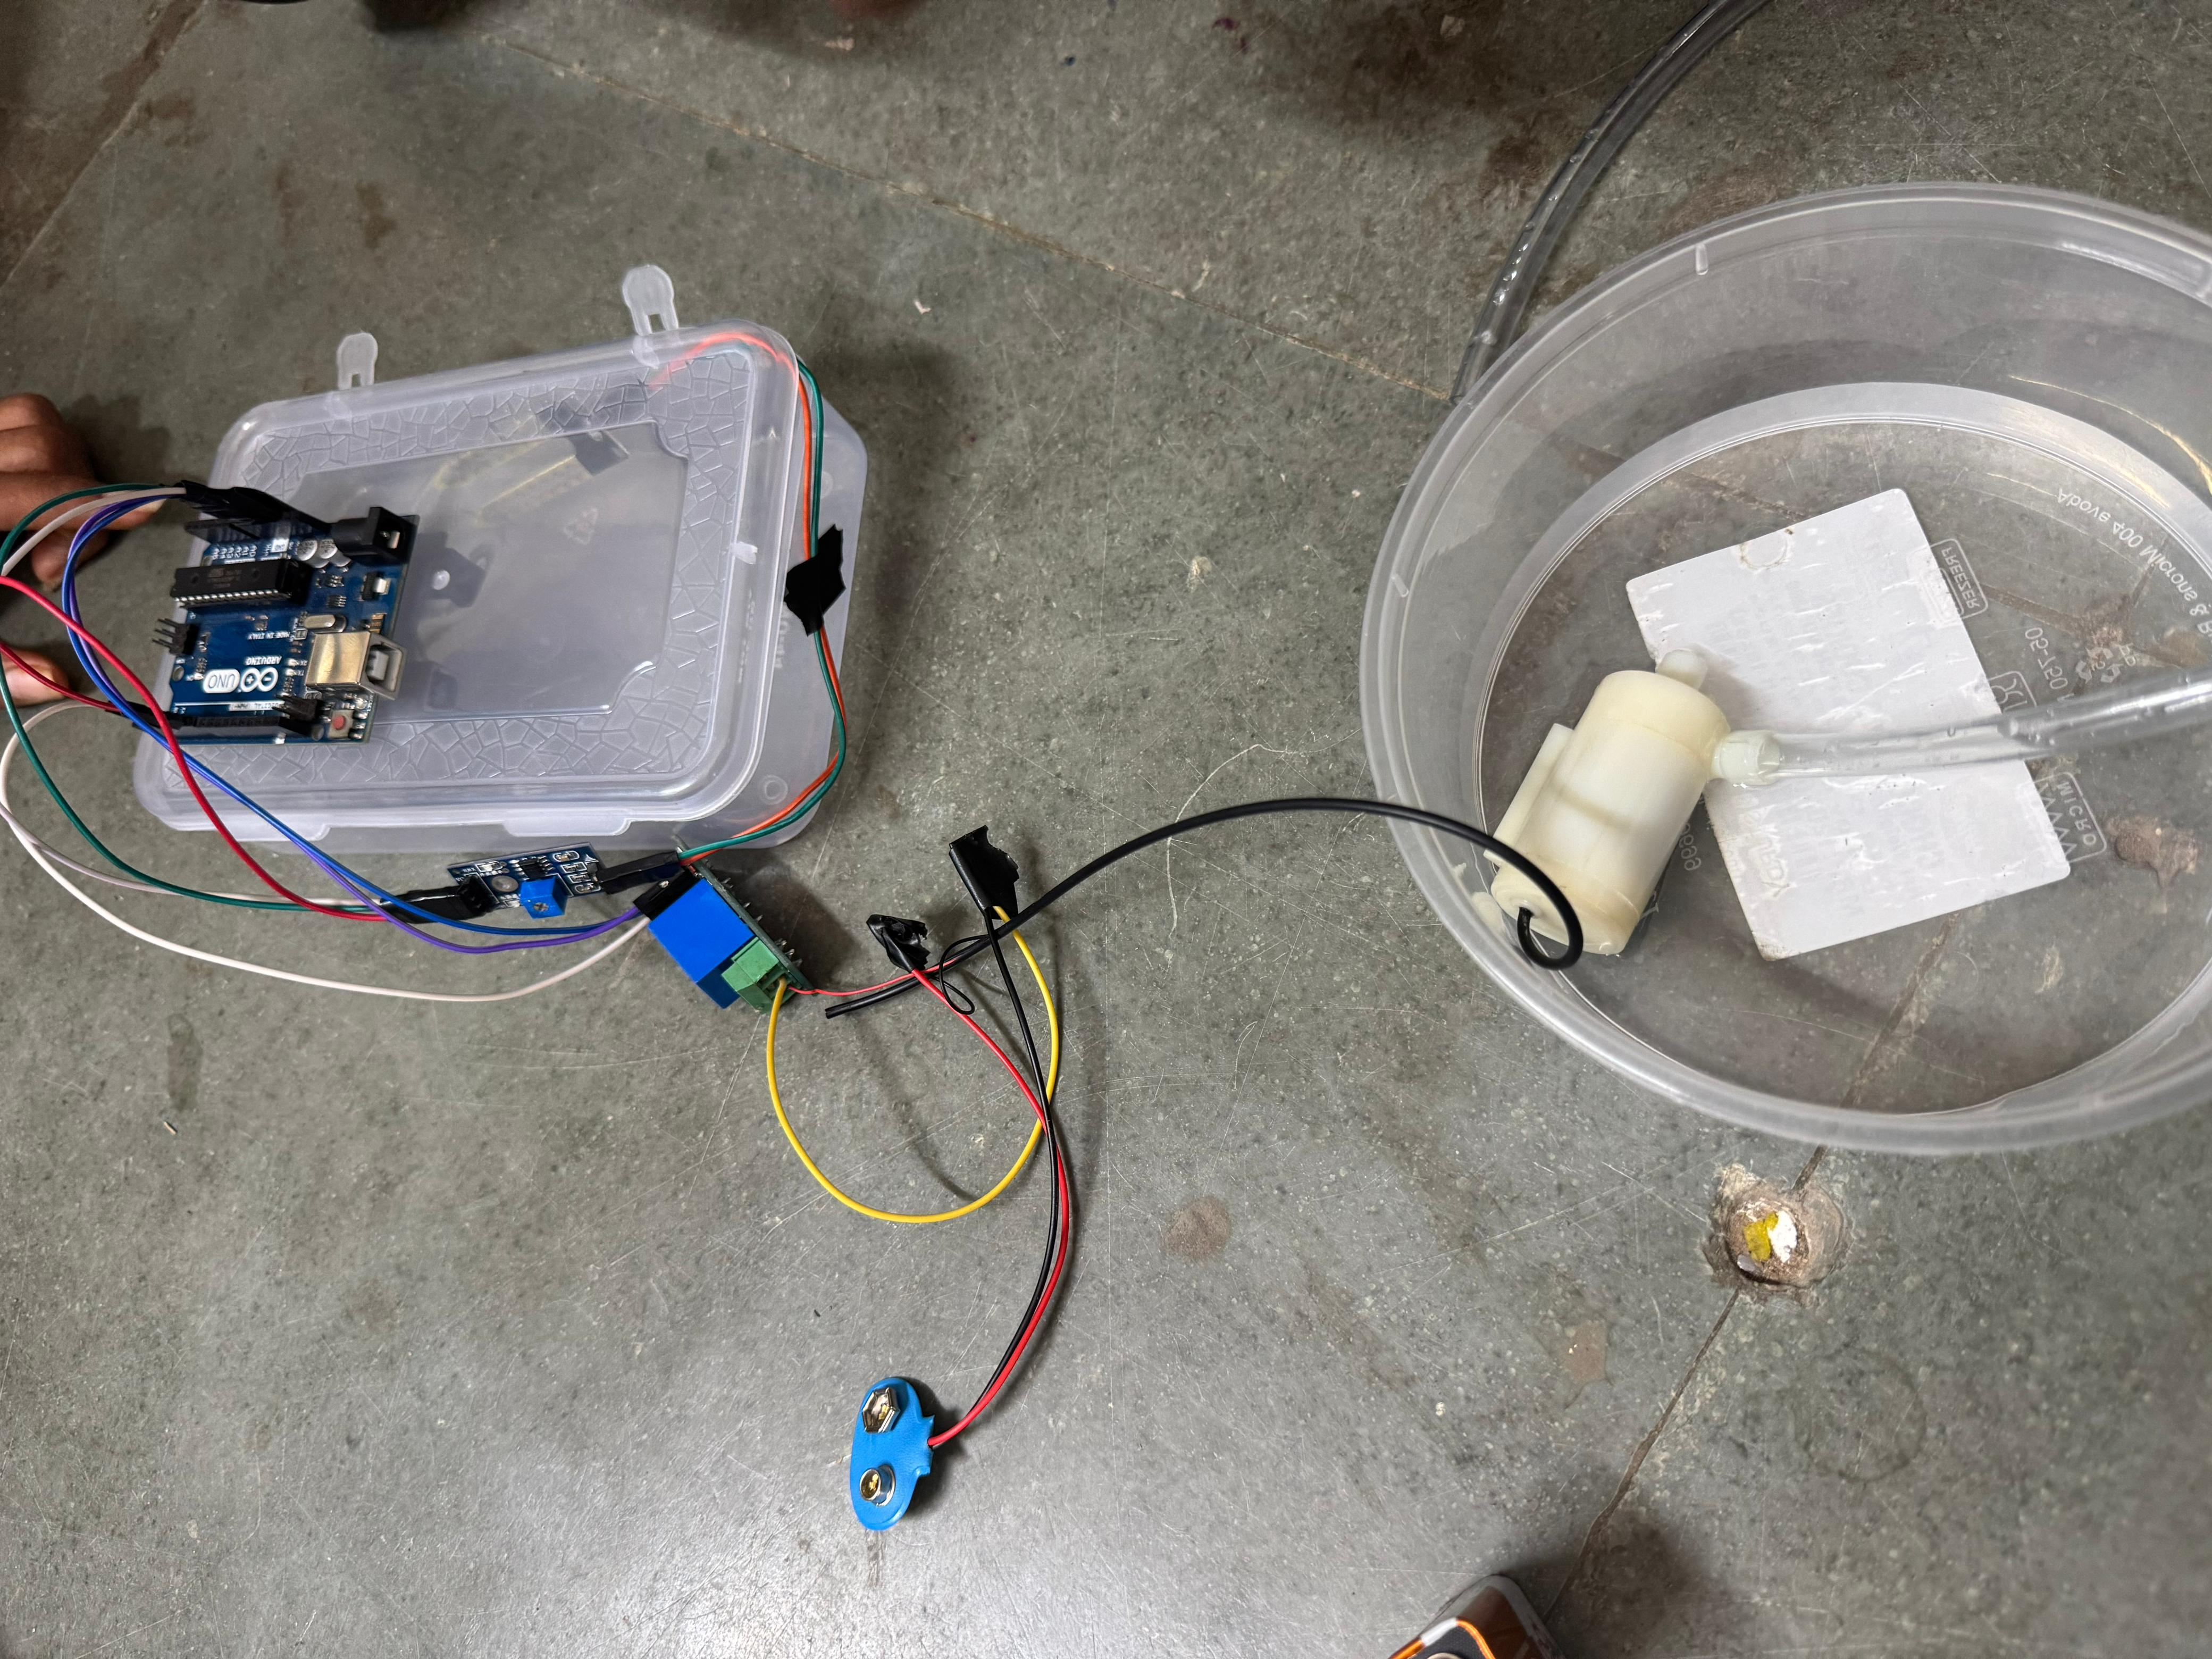
1.1) PROTOTYPE TITLE
SMART IRRIGATION SYSTEM
1.

Slide 4
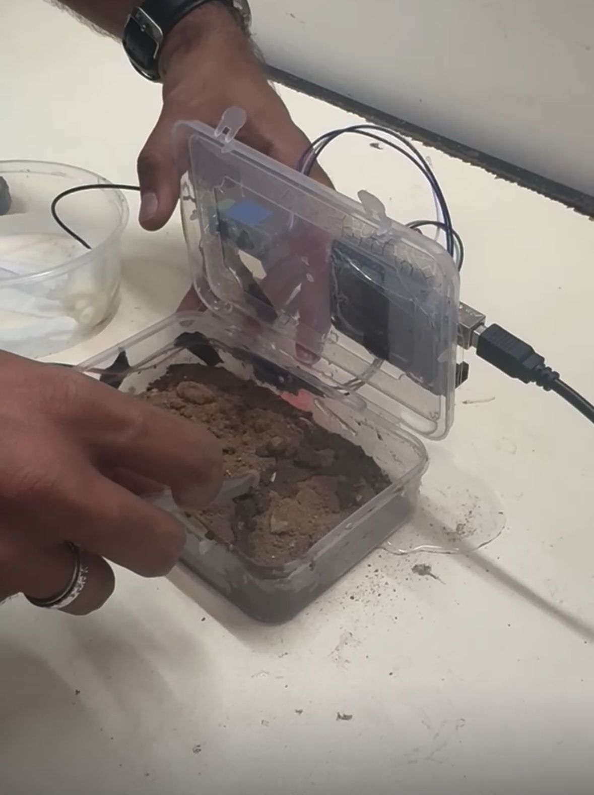
1.2) PROJECT DEFINITION
A smart irrigation system with Arduino refers to an automated watering system that utilizes Arduino, a microcontroller platform, to efficiently manage and control the irrigation process
This system typically incorporates sensors to measure soil moisture levels, weather conditions, and other relevant parameters
The Arduino processes this data to make informed decisions, activating or deactivating irrigation based on the specific needs of the plants
The goal is to optimize water usage, conserve resources, and promote healthier plant growth
2.

Slide 5
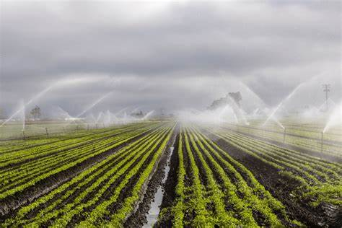
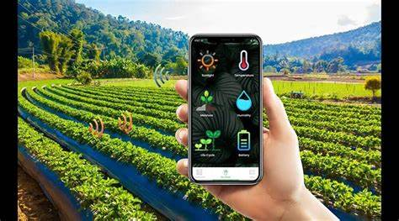
1.3) GROUP DETAILS
SMART IRRIGATION SYSTEM USING ARDUINO
DEVELOPERS
PATEL KEYA
PATEL AANSHI
LUHAR AASTHA
THAKOR PARTH
SINGH AYUSH
3.

Slide 6
1.4) SYSTEM REQUIREMENTS SPECIFICATION: HARDWARE REQUIREMENTS
SR. NO | Category | Specification | Quantity
1. | Microcontroller (Control Unit) | Arduino Uno | 1
2. | Sensor (Input Device) | Soil Moisture Sensor | 1
3. | Switching Device (Control Device) | Relay Module | 1
4. | Actuator (Output Device) | Water Pump | 1
5. | Connecting Components (Wiring) | Jumper Wires | ~10 - 12
6. | Power Device (Energy Source) | Battery | 1
7. | Mechanical Component (Output Device) | Water Pipe | 1
4.

Slide 7
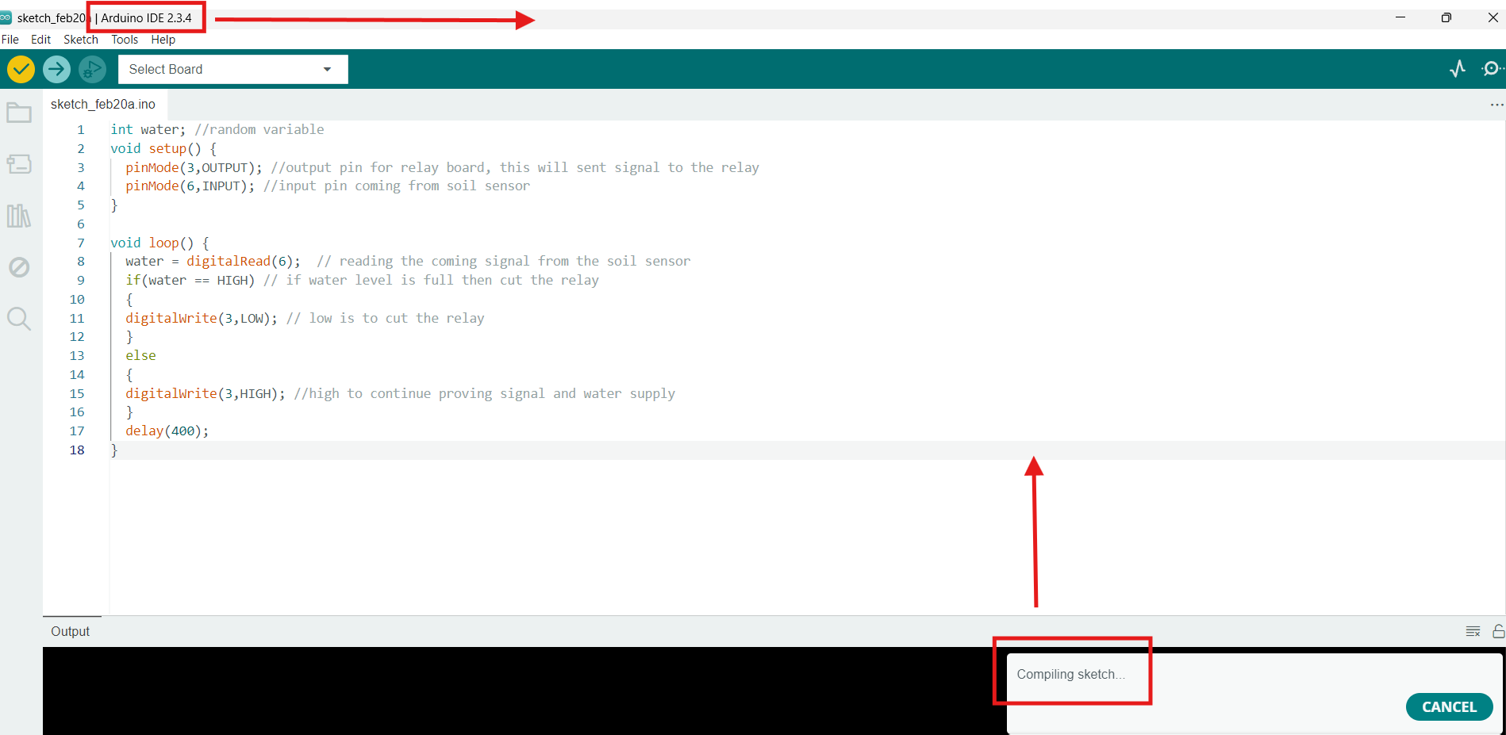
1.4) SYSTEM REQUIREMENTS SPECIFICATION: SOFTWARE REQUIREMENTS
Used to WRITE AND UPLOAD code to the Arduino uno
Also used to COMPILE the code
5.

Slide 8
1.5) HARDWARE DEVICE COST SPECIFICATION
SR. NO | Category | Specification | Quantity | Cost
1. | Microcontroller (Control Unit) | Arduino Uno | 1 | 400
2. | Sensor (Input Device) | Soil Moisture Sensor | 1 | 150
3. | Switching Device (Control Device) | Relay Module | 1 | 100
4. | Actuator (Output Device) | Water Pump | 1 | 100
5. | Connecting Components (Wiring) | Jumper Wires | ~10 - 12 | 100 (pack of 10)
6. | Power Device (Energy Source) | Battery | 1 | 40
7. | Mechanical Component (Output Device) | Water Pipe | 1 | 60
6.

Slide 9
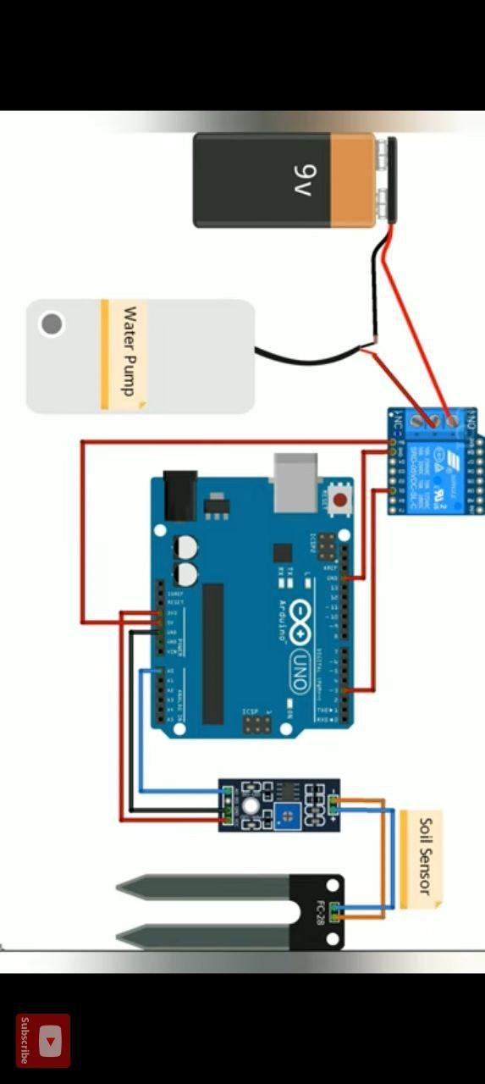
2.1) CIRCUIT DESIGN - DIAGRAM
Relay Module
Arduino Uno
Battery
7.

Slide 10
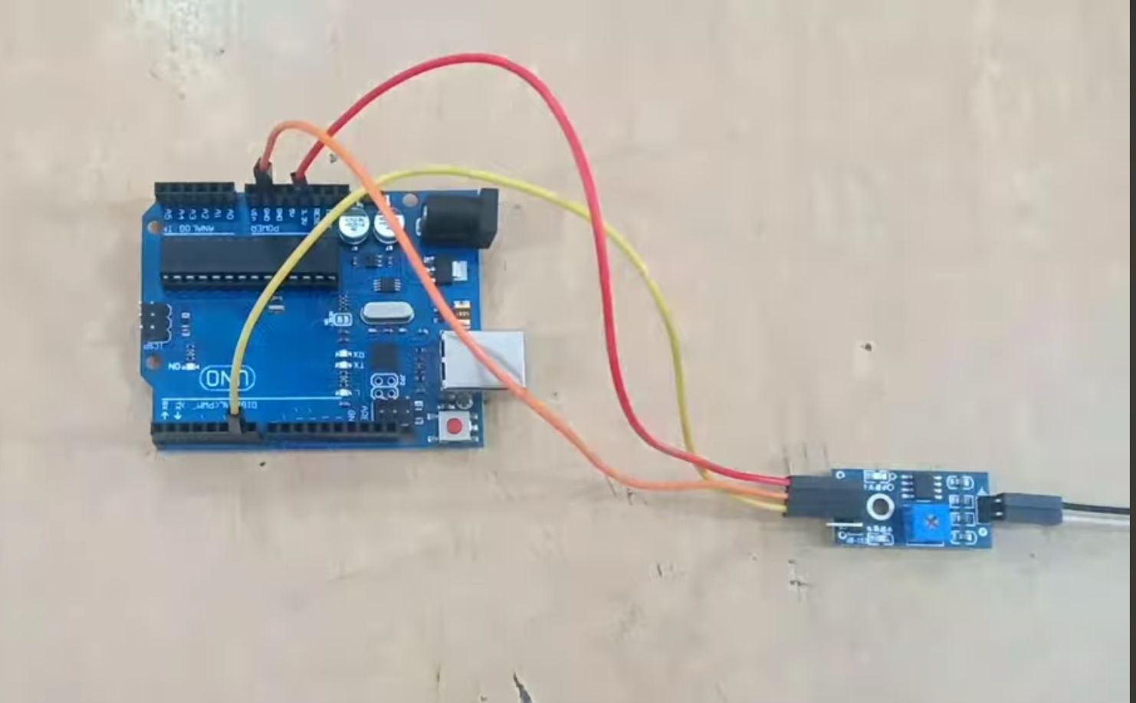
2.2) ASSEMBLING THE COMPONENTS – STEPS
Step:1) Connect the Soil Moisture Sensor to Arduino
VCC → Connect to 3.3V on Arduino
GND → Connect to GND on Arduino
A0 (Analog Output) →
Connect to Digital 6 on Arduino
8.

Slide 11
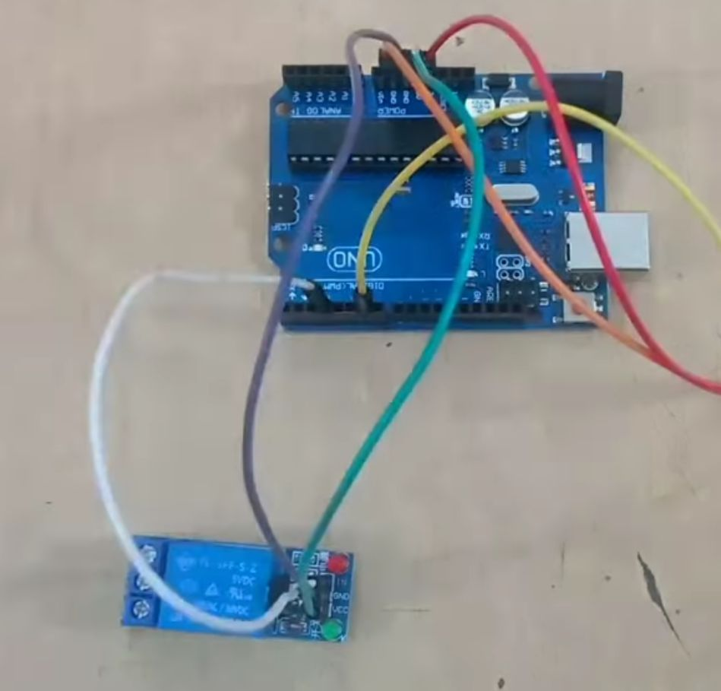
2.2) ASSEMBLING THE COMPONENTS – STEPS
Step:2) Connect the Relay Module to Arduino
The relay module acts as a switch for the water pump.
VCC → Connect to 5V on Arduino
GND → Connect to GND on Arduino
D0 IN (Signal Pin) → Connect to Digital Pin 3 on Arduino
9.

Slide 12
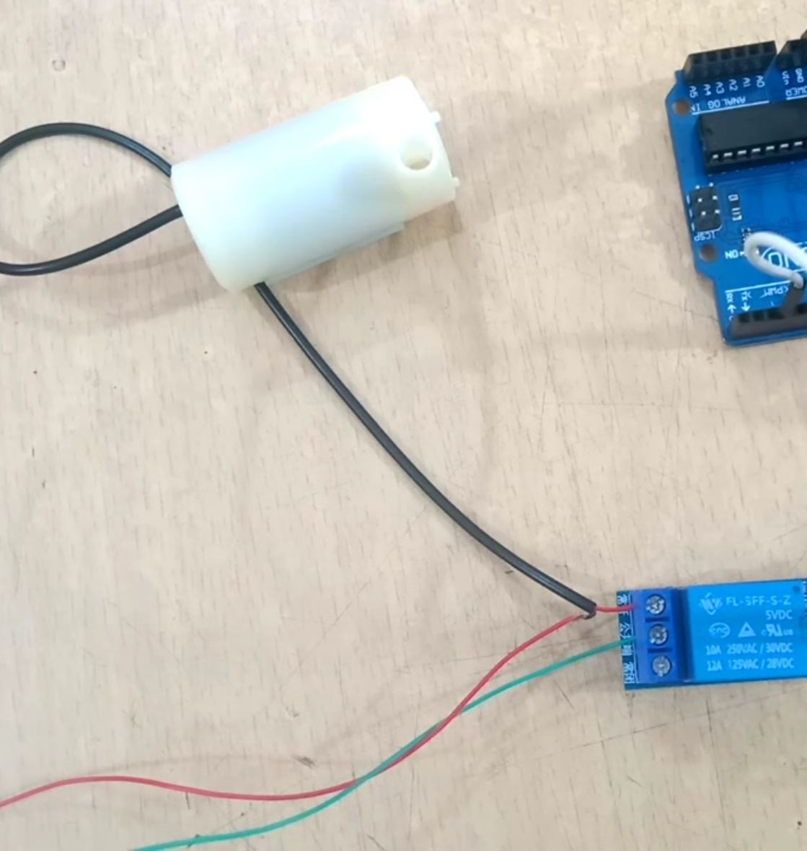
2.2) ASSEMBLING THE COMPONENTS – STEPS
Step:3) Connect the Water Pump to the Relay Module
The relay module has three output terminals (NO, COM, NC).
Connections:
COM (Common Terminal) → Connect to the positive terminal of the water pump.
NO (Normally Open Terminal) → Connect to the positive terminal of the battery.
Negative terminal of the pump → Connect directly to the battery’s negative terminal.
10.

Slide 13
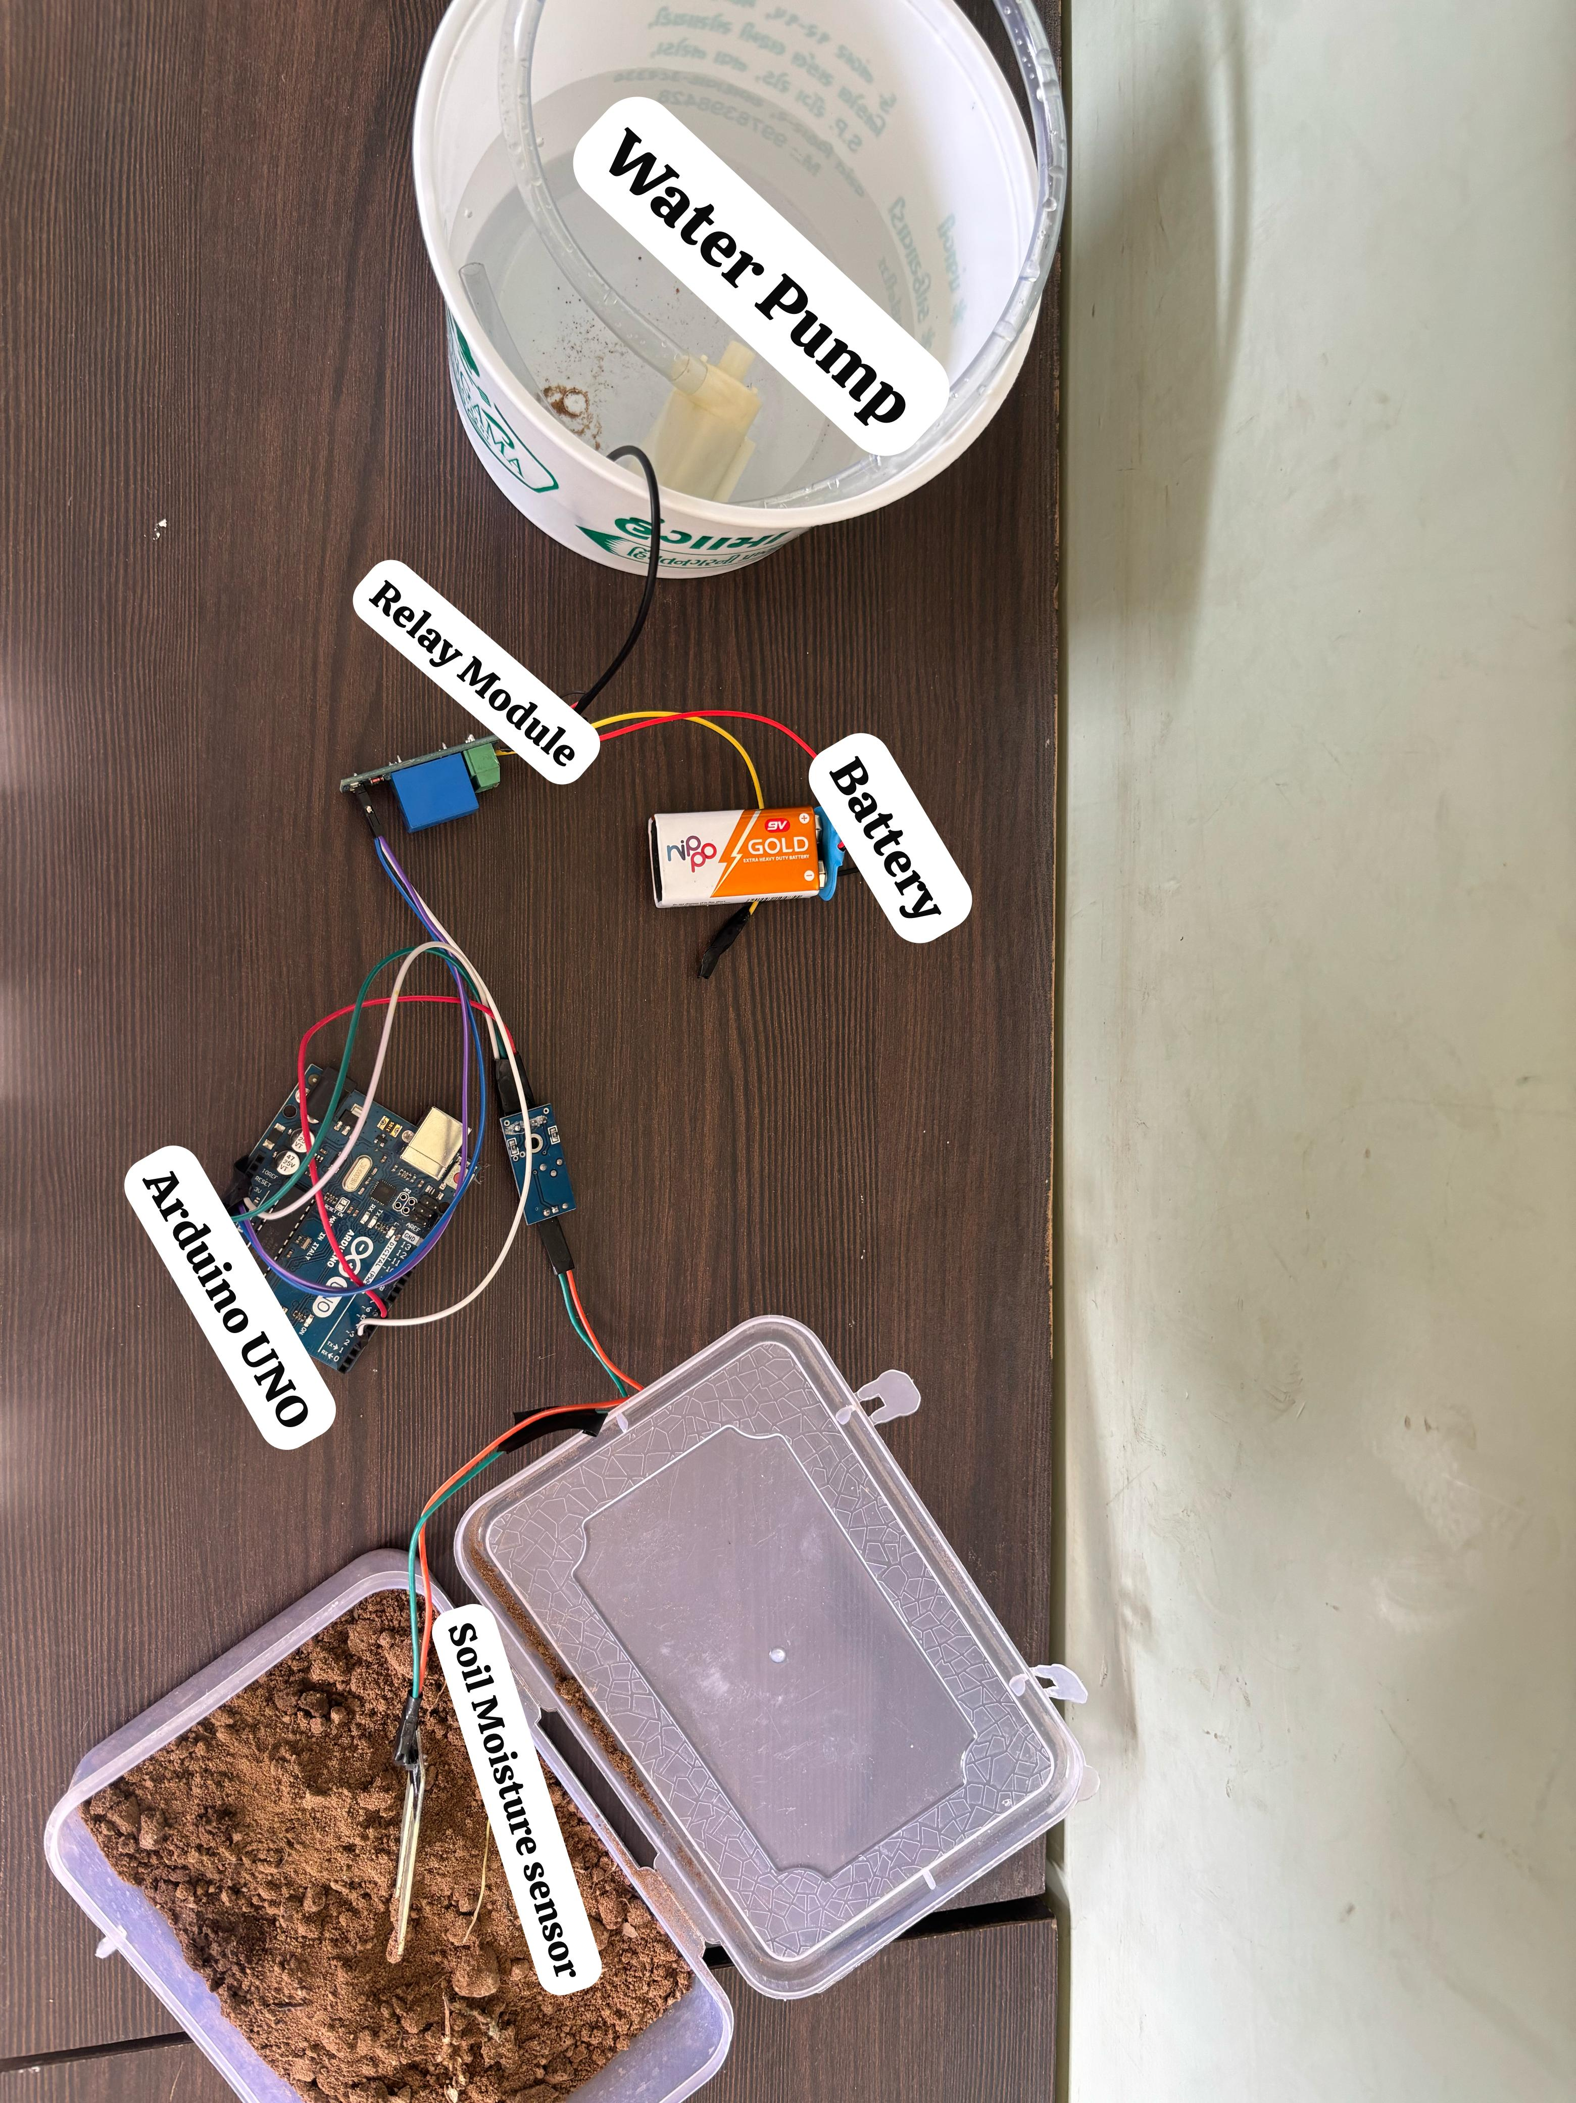
2.3) LABELLED DIAGRAM OF PROTOTYPE
11.

Slide 14
2.4) DEVELOPING THE LOGIC:
COMPLETE CODE WITH EXPLAINATION
int water; // Variable to store soil moisture sensor readings
void setup() {
pinMode(3, OUTPUT); // Pin 3 is connected to the relay (controls water pump)
pinMode(6, INPUT); // Pin 6 is connected to the soil moisture sensor
}
void loop() {
water = digitalRead(6); // Read the soil moisture sensor value (HIGH = Wet, LOW = Dry)
if (water == HIGH) { // If soil is wet, turn OFF the pump
digitalWrite(3, LOW); // Deactivate relay (Pump OFF)
}
else { // If soil is dry, turn ON the pump
digitalWrite(3, HIGH); // Activate relay (Pump ON)
}
delay(400); // Short delay to prevent rapid switching
}
12.

Slide 15
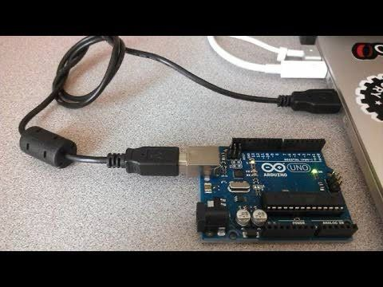
2.5) BURNING THE CODE INTO THE PROTOTYPE:
STEPS
Connect Arduino to Computer using a USB cable (Type A to Type B).
Open Arduino IDE and ensure it is installed.
Select Board: Go to Tools > Board > Arduino Uno.
Choose the Correct Port: Tools > Port > Select COM Port (e.g., COM3).
Paste/Write the Code in Arduino IDE.
Verify the Code (Click ✅ to check for errors).
Upload the Code (Click ➡ to burn the code into Arduino).
Now the Smart Irrigation System is programmed and ready to work!
13.

Slide 16
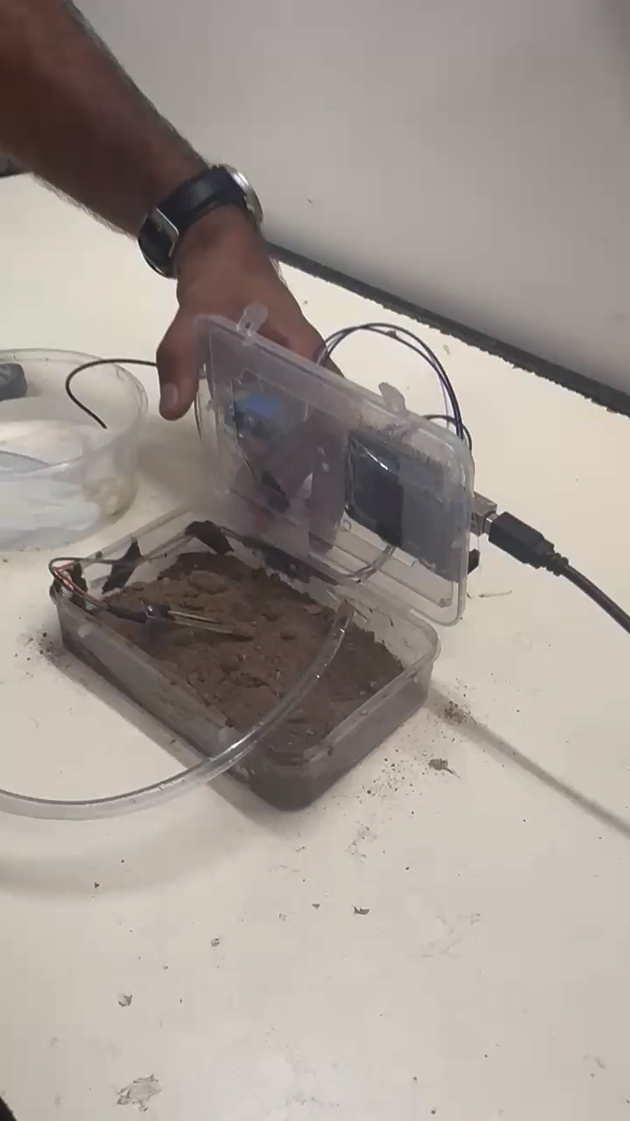
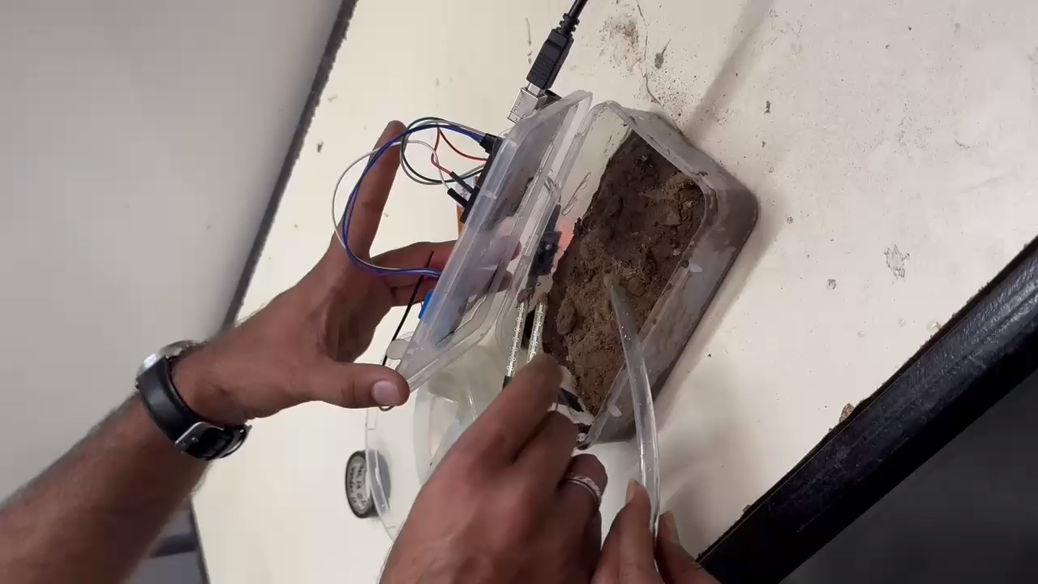
3.1) WORKING PROTOTYPE:
VIDEO
14.

Slide 17
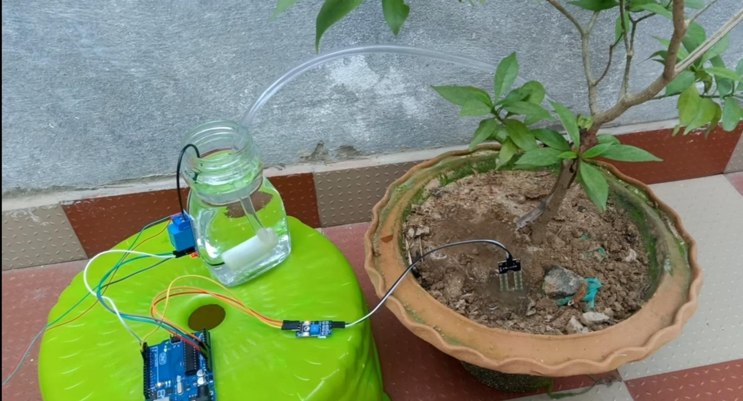
3.2) PROTOTYPE ADVANTAGES
Water Conservation – Uses sensors to optimize irrigation, reducing water wastage.
Automation – Eliminates manual watering, saving time and effort.
Cost-Effective – Low-cost components make it affordable for small farms and gardens.
Efficient Plant Growth – Provides the right amount of water, improving crop health.
User-Friendly – Simple setup and operation with minimal maintenance required.
Reduces Labor Costs – Minimizes the need for manual watering, saving time and effort.
Adaptable to Various Environments – Can be used in home gardens, greenhouses, and farms.
15.

Slide 18



3.3) PROTOTYPE CHALLENGES
Sensor Inaccuracy – Readings may be inconsistent.
Power Dependency – Requires a stable power supply.
Weather Sensitivity – Lacks integration with real-time weather data.
Scaling Costs – Expanding for larger farms increases cost.
Maintenance Needs – Sensors and pumps require regular upkeep.
16.

Slide 19
3.4) PROTOTYPE REAL LIFE APPLICATIONS
Agriculture: Efficient water management for crops, reducing water waste, and improving yield through precise irrigation based on soil moisture and weather conditions.
Gardens and Lawns: Automating watering schedules for home gardens or public parks, ensuring plants are watered as needed, preventing over- or under-watering.
Greenhouses: Monitoring and controlling irrigation in controlled environments to maintain optimal moisture levels for plant growth.
Golf Courses: Managing large green spaces efficiently by using smart irrigation to maintain turf health while conserving water.
Commercial Landscaping: Optimizing water usage for landscapes around office buildings, hotels, or other commercial properties, ensuring greenery stays healthy with minimal water use.
Smart Cities: Part of broader smart city initiatives, where public parks and urban green spaces use IoT-based smart irrigation to conserve water and maintain urban ecosystems.
17.

Slide 20
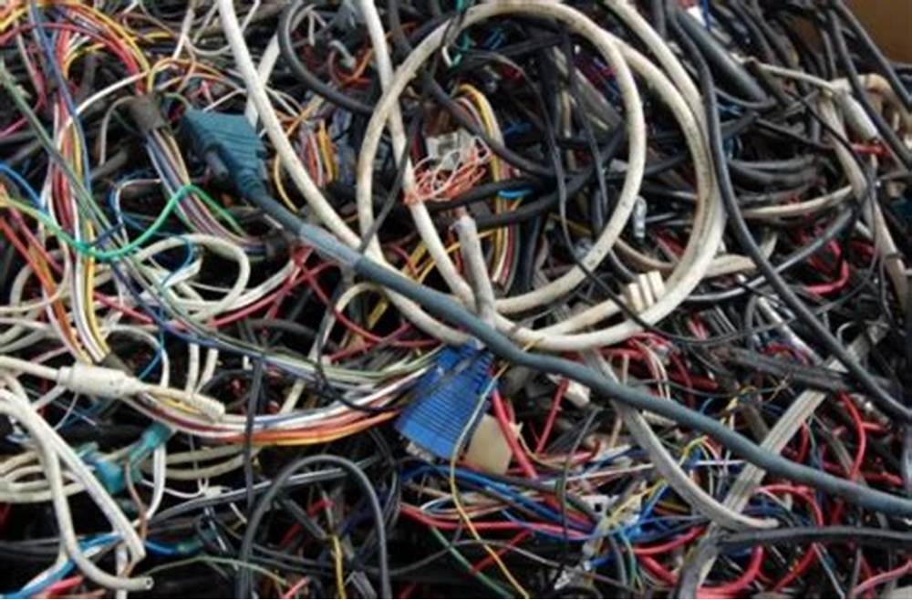

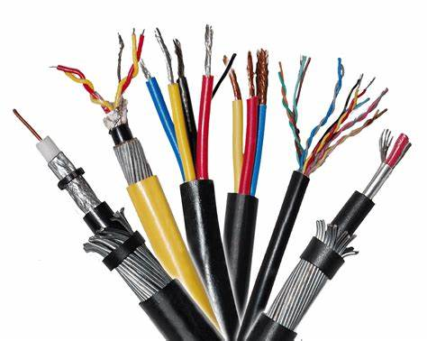
3.5) ROBOPEDIA PROJECT WORK:
I TO IV FIVE LEARNINGS
Understanding Automation & Robotics – Learned how Arduino and sensors automate processes.
Circuit Design & Hardware Integration – Gained hands-on experience in connecting and troubleshooting electronic components.
Programming & Code Implementation – Developed coding skills in C/C++ for Arduino-based projects.
Problem-Solving & Troubleshooting – Identified and resolved errors in hardware connections and software logic.
Project Planning & Execution – Learned to design, test, and optimize a working prototype.
18.

Slide 21
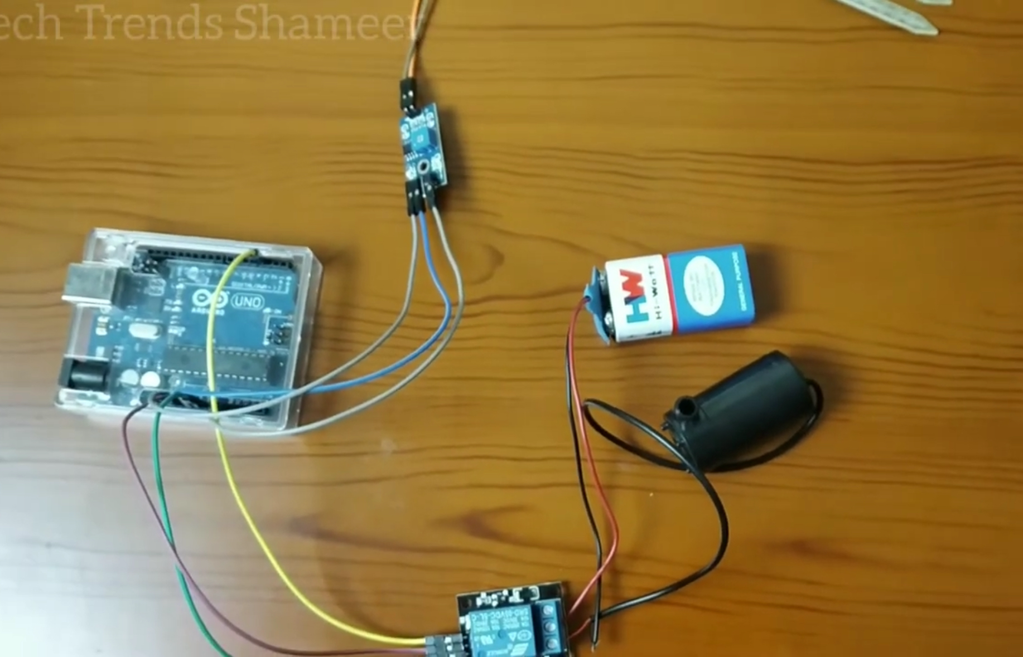
3.6) PROJECT WORK – 3:
CONCLUSION
Successful Implementation – The prototype was successfully built and tested.
Automation Achieved – The system efficiently automates irrigation using Arduino and sensors.
Water Conservation – Helps reduce water wastage by irrigating only when needed.
Improved Efficiency – Eliminates manual intervention, making the process faster and more reliable.
Future Scope – Can be enhanced with IoT integration, weather-based automation, and mobile control.
19.

Slide 22
3.7) REFERENCES
https://www.raypcb.com/smart-irrigation-system-using-arduino/#:~:text=Smart%20irrigation%20systems%20save%20about,amount%20of%20water%20it%20saves.
https://circuitdigest.com/microcontroller-projects/interfacing-soil-moisture-sensor-with-arduino-uno
https://www.renkeer.com/smart-irrigation-technology-and-system/
https://dipslab.com/smart-irrigation-system/
https://www.linkedin.com/pulse/future-smart-irrigation-mobitech-wireless-solution
20.

